Slide 1
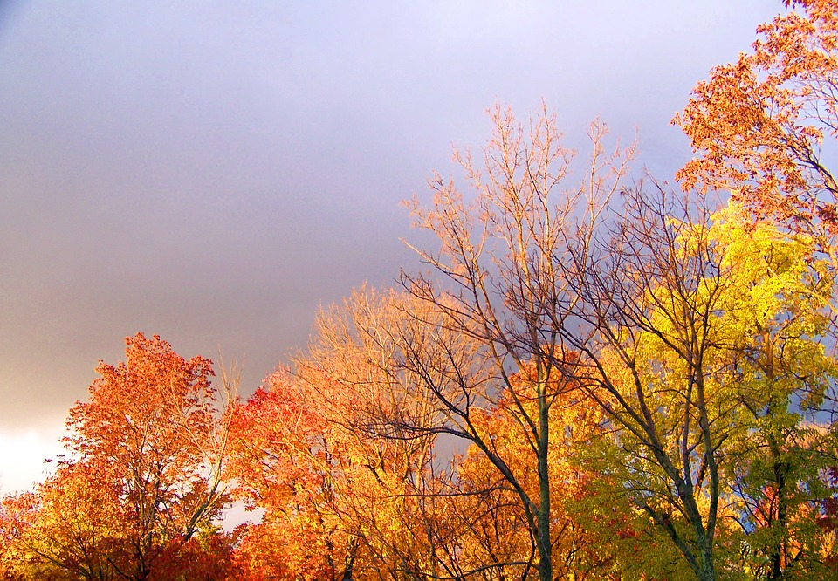
Weather Forecasting Website
Bhaskar Kulshrestha
2001641530020
B.Tech second year - CS (AI and ML)

Slide 2
Objective
Weather forecasting is the application of science and technology to predict the conditions of the atmosphere for a given location.
Weather forecasts are made by collecting quantitative data about the current state of the atmosphere,land,and ocean and using meteorology to project how the atmosphere will change at a given place.
Human input is still required to pick the best possible forecast model to base the forecast upon, which involves pattern recognition skills, teleconnections, knowledge of model performance, and knowledge of model biases.

Slide 3
Problem Statement
In this project you have a basic website in which you can find the weather of any location , any place by given name as a input .
According to the name given we can find the weather and related conditions accordingly and hence respond accordingly.

Slide 4
Introduction
Weather forecasting is the prediction of what the atmosphere will be like in a particular place by using technology and scientific knowledge to make weather observations. In other words, it's a way of predicting things like cloud cover, rain, snow, wind speed, and temperature before they happen.

Slide 5
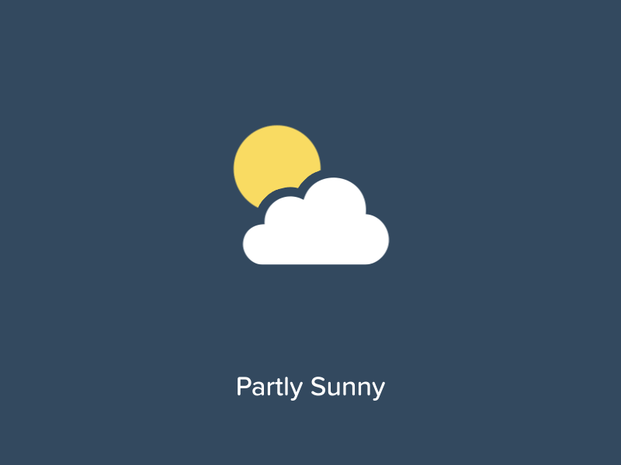
Weather forecasting is the application of science and technology to predict the conditions of the atmosphere for a given location and time. Weather forecasts are made by collecting quantitative data about the current state of the atmosphere, land, and ocean and using meteorology to project how the atmosphere will change at a given place. Once calculated manually based mainly upon changes in barometric pressure, current weather conditions, and sky condition or cloud cover, weather forecasting now relies on computer-based models that take many atmospheric factors into account.

Slide 6
Methodology
The processes we have used are as follows :-

Slide 7
The Programming of the code is using the 4 concepts, namely :
HTML 5
CSS 3
JAVASCRIPT
API – Application programming interface

Slide 8
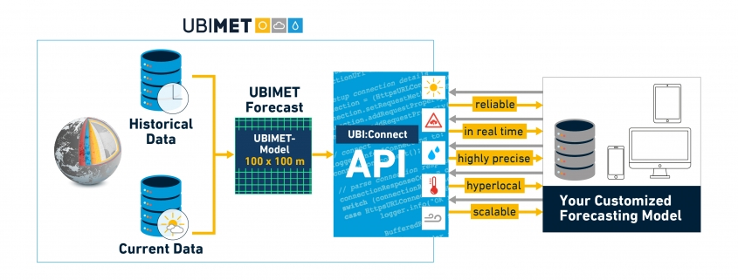
Project Flowchart

Slide 9
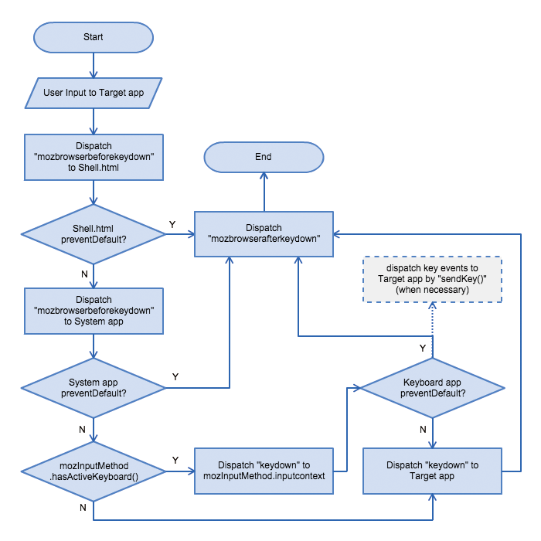

Slide 10
Working summary
In first step the user gives the input as name of city
Now the inputted value will be transmitted to the server with the help of JavaScript .
Now the transfer will be handled to the API server here we use open-weather API .
Now the API process the value and then it returns the result to the requested IP address.
Now the JavaScript will handle the result to the browser
And then the result will be displayed to the user .

Slide 11
Output Screenshots

Slide 12
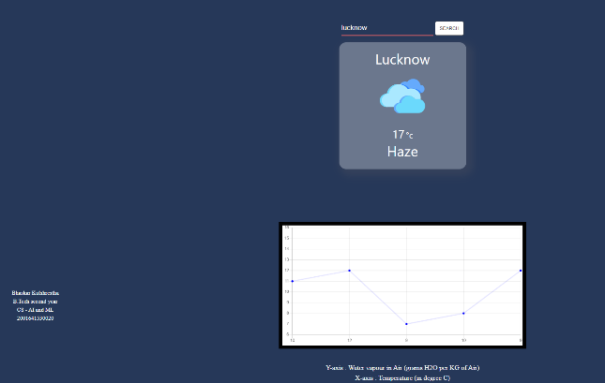

Slide 13
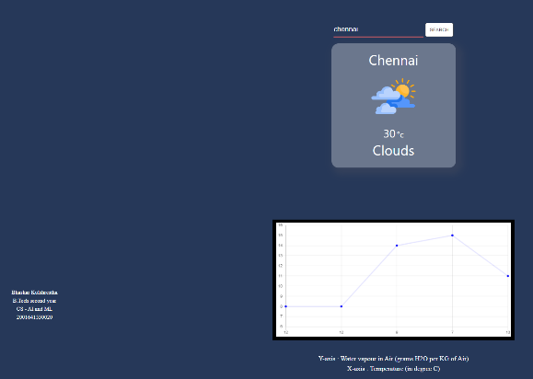

Slide 14
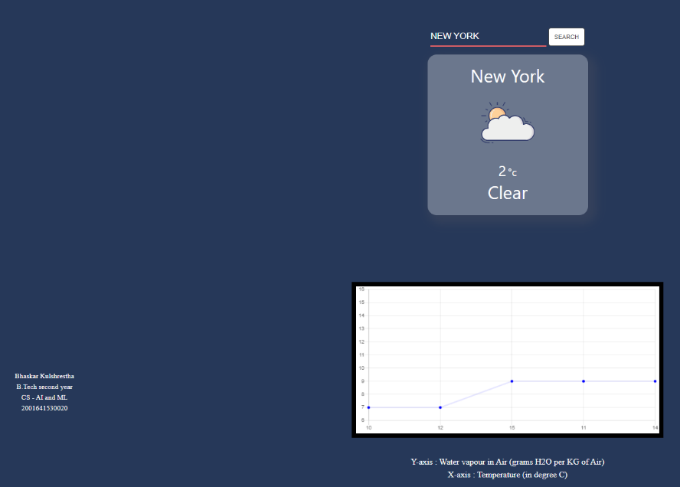

Slide 15

Project Requirements
INTEL PROCESSOR (7TH GEN OR ABOVE) and AMD’s 2nd generation Ryzen 5’s and 7’s or higher.
WINDOWS 10 OPERATING SYSTEM(RECOMMENDED)
SSD STORAGE FOR FASTER REVIEW BUT NO WORRIES HDD WILL ALSO WORK.
A STABLE INTERNET CONNECTION FOR FASTER ACCESSING .

Slide 16
Application
Weather Forecasting.
Check the weather to plan your day.
Precautionary measures can be taken before any disaster happen.
To Predict the climate of a location and to study climate changes.
Future climate prediction (example – prediction of rainfall ).

Slide 17
Benefits
This website can be used as fulltime working website for finding condition of the weather.
The website is fully responsive and hence can be used in any device.
This website can also be adjusted according to user’s needs

Slide 18
Limitations
This website does not have a feature of autocorrect that is if we enter the name of city wrong then it will give output as “incorrect – input” so we have to give input of the city carefully.
This website cannot give the data of very small city accurately.

Slide 19
Future Scope
This website can helps us to find various climatic conditions across the world without any big machinery , this can be displayed in any device
Due to severe climatic changes a lot of natural phenomena changes like changes of rainfall pattern so this is to be measured to reduce the natural disasters.
A person may plan his/her day by seeing the weather pattern
We need to update the data of the servers to maintain the accuracy of the system.
For differently abled persons a text-speech converter , visual icons can also be installed for their convenience.

Slide 20

Results
User is able to check the weather of any part of the world .
User will be able to operate it in any device .
Users will be able to study the climate changes .

Slide 21
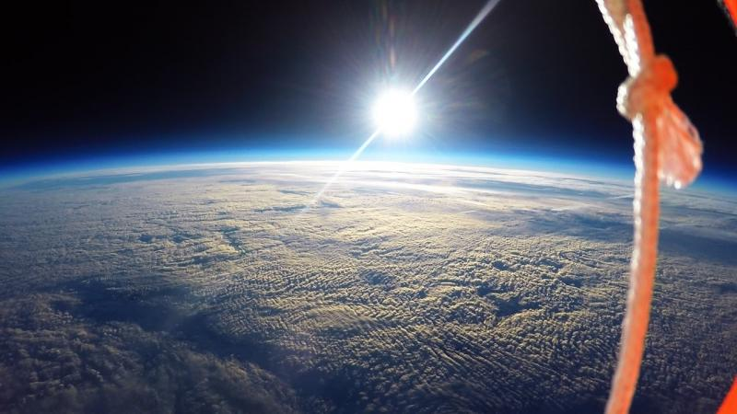


THANK Y U
The environment is where we all meet; where all of us have a mutual interest; it is the one thing all of us share.

